Slide 1
Articulation Information and Broad Phone Classes
Research Assistant: Yen-Ju Lu
Advisor: Yu Tsao

Slide 2
In order to form consonants,
the airstream through the vocal tract must be obstructed in some way.
Consonants can be classified according to the place and manner of this obstruction.
P. Ladefoged and K. Johnson, A Course in Phonetics. Nelson Education, 2014.

Slide 3
Consonants
Place of
Obstruction
Manner of
Obstruction
= +

Slide 4
Articulation Information and Broad Phone Classes
1

Slide 5
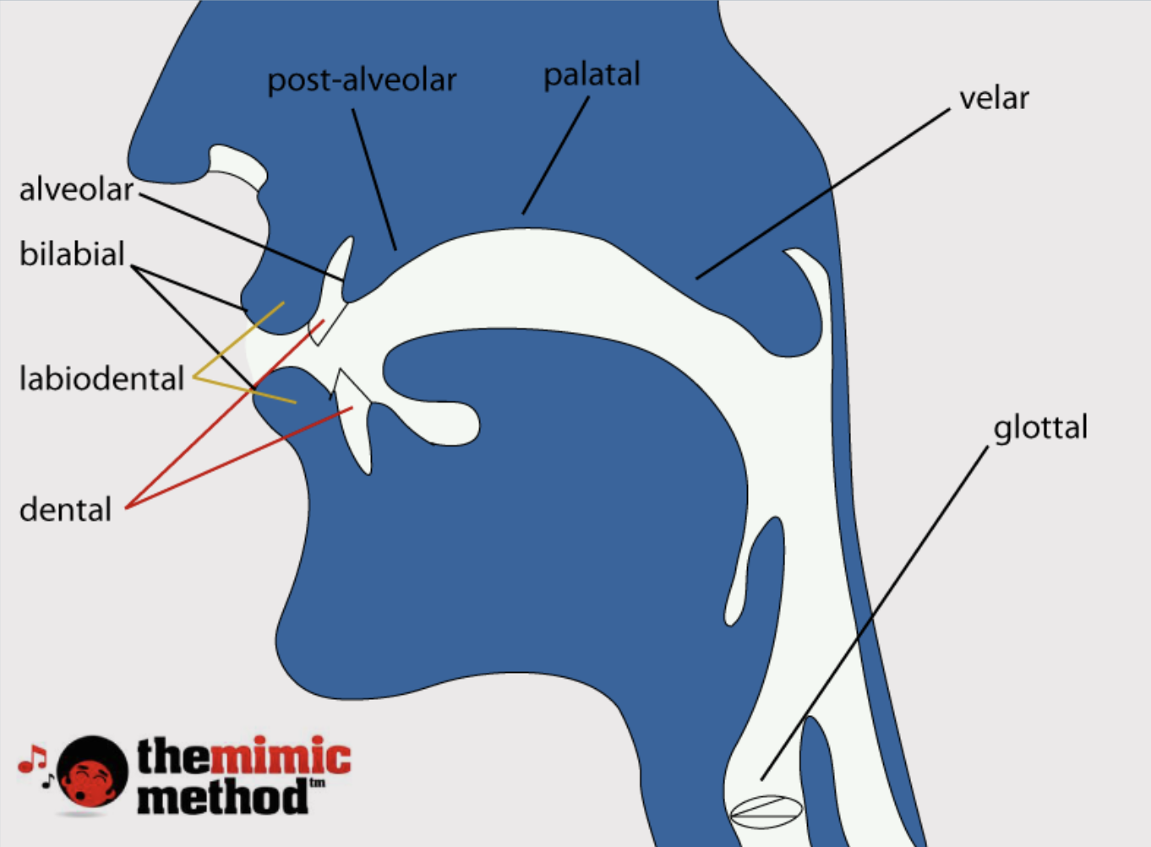
Place of Articulation

Slide 6
Manner of Articulation
Stops | complete blockage
Fricatives | partial blockage
Affricates | stop + fricative
Nasals | through nasal cavity
Glides | take the shape of the vowel
Liquids | lowering both sides of the tongue

Slide 7
Manner of Articulation
Stops | [p] [t] [k] [b] [d]
Fricatives | [f] [v] [s] [z]
Affricates | [tʃ] [dʒ]
Nasals | [m] [n] [ŋ]
Glides | [j] [w]
Liquids | [l] [r]

Slide 8
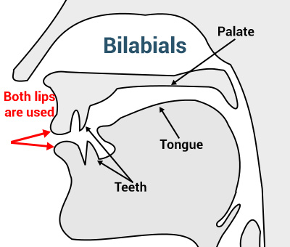
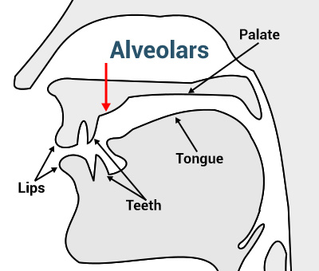
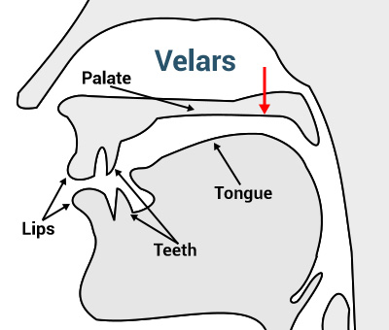
Manner of Articulation
Voiced Nasal Stops
Bilabial | Alveolar | Velar
[m] | [n] | [ŋ]

Slide 9
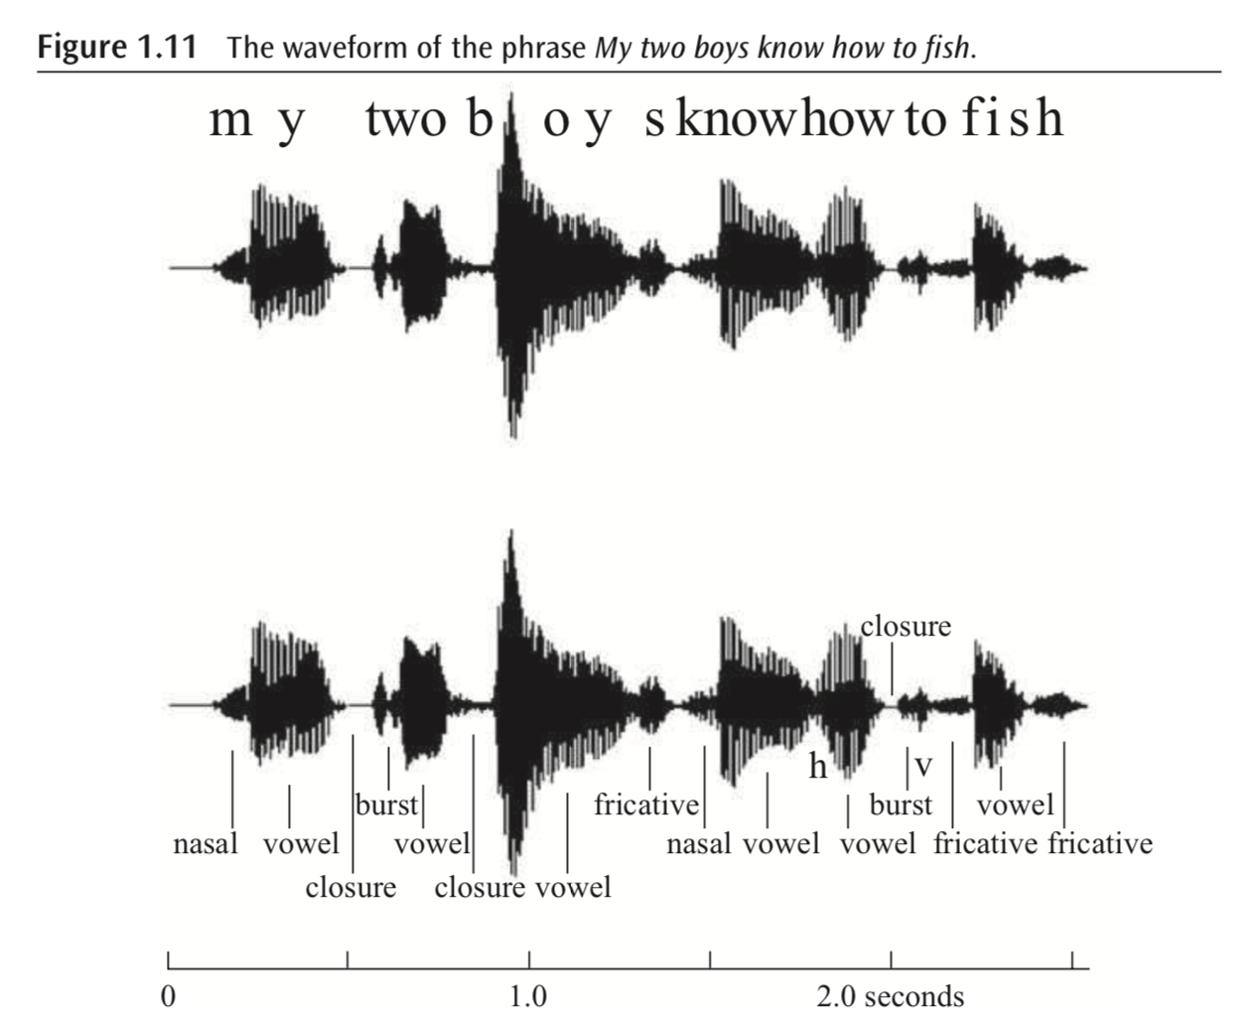
Articulation Information

Slide 10
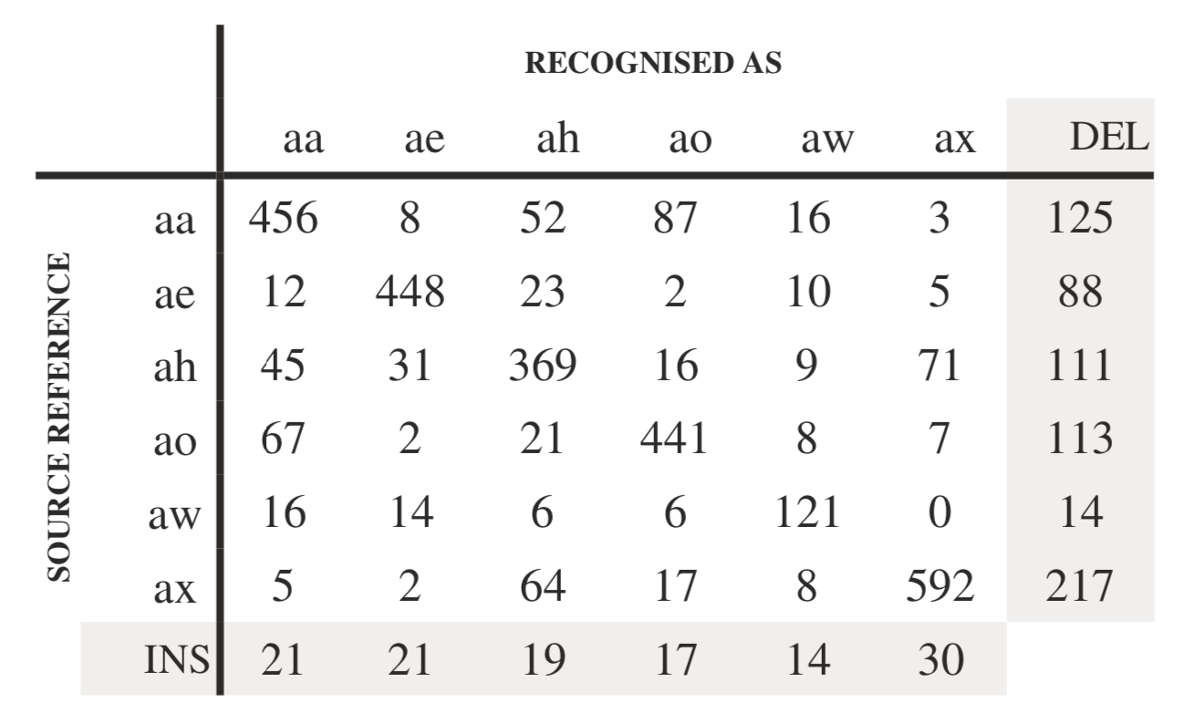
Data-driven Information
Part of a confusion matrix:
output of TIMIT-based phone recognition system.

Slide 11
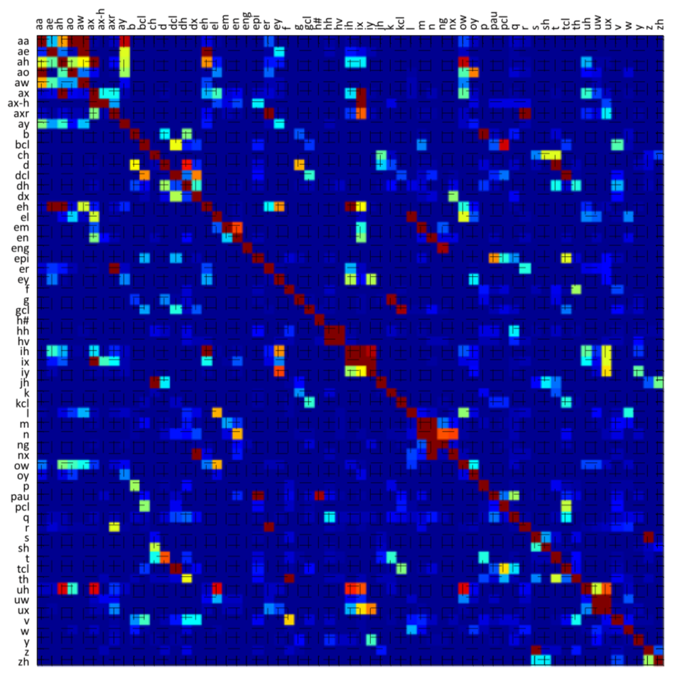
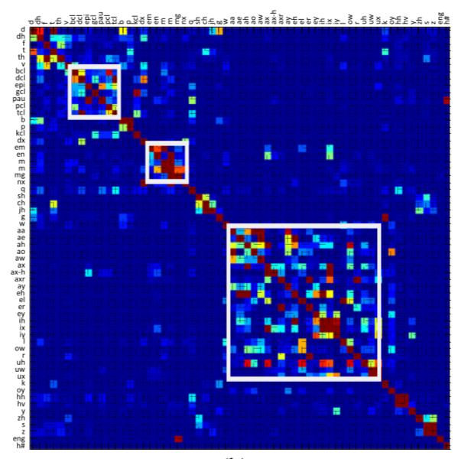
Data-driven Information
Rearrange Confusion Matrix -> Clustering

Slide 12

Broad Phone Classes
Stops
Fricatives
Affricates
Nasals
Glides
Liquids
Place of articulation BPCs
(PBPCs)
Manner of articulation BPCs
(MBPCs)
Data-driven BPCs
(DBPCs)

Slide 13
Broad Phone Classes on Speech Enhancement
2

Slide 14
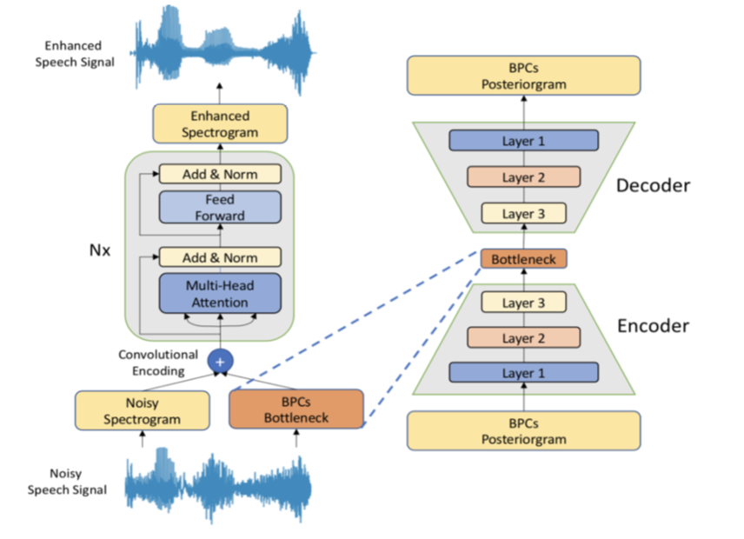
BPC Posterior-gram (BPCPG) (Additional input feature)
1. Train an Acoustic Model to estimate BPCs in each frame.
2. Know which phone/BPC help the SE model to generate better enhanced speech.

Slide 15
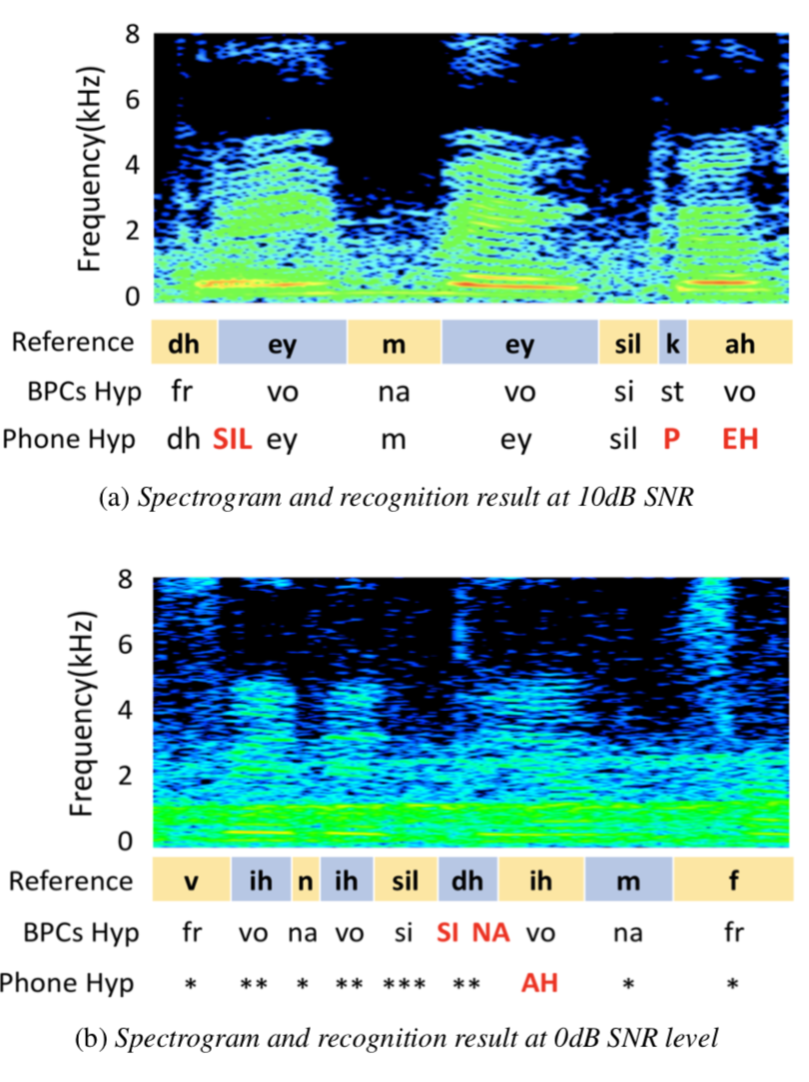
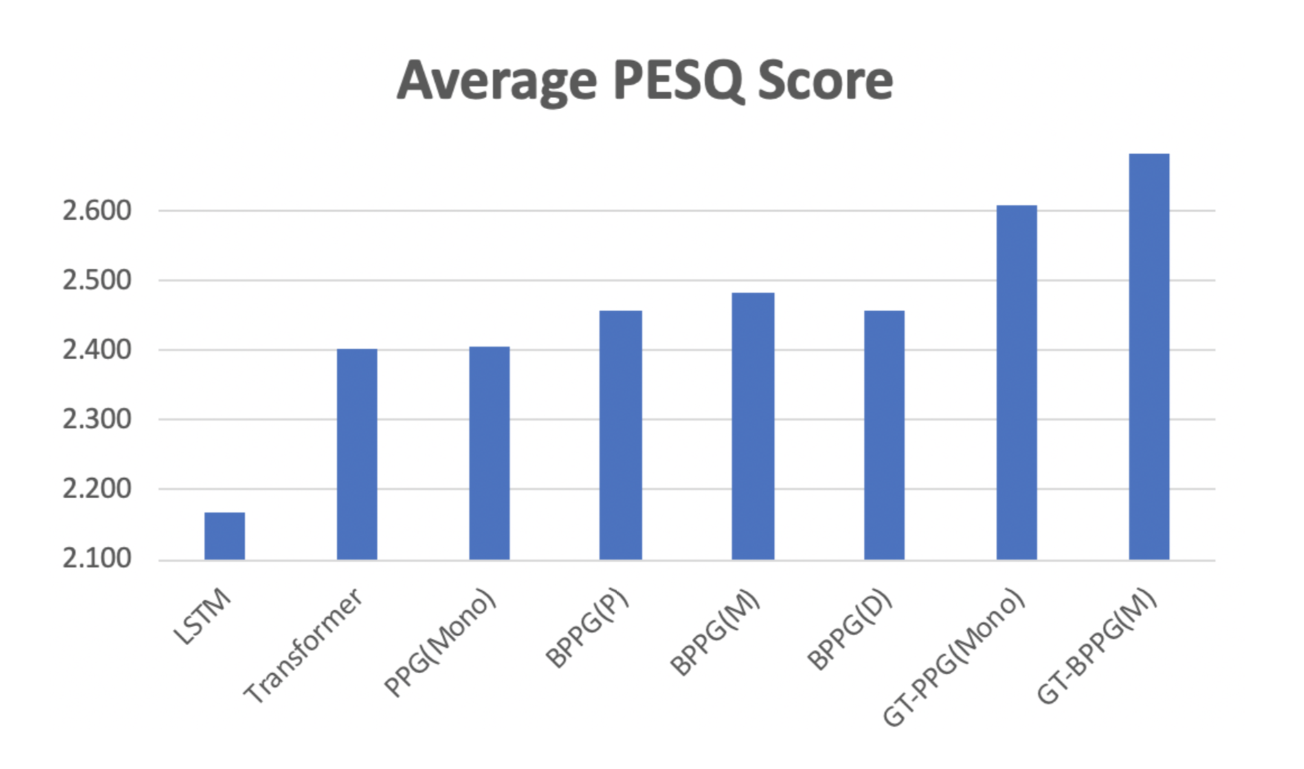
BPC Posterior-gram (BPCPG) (Additional input feature)

Slide 16
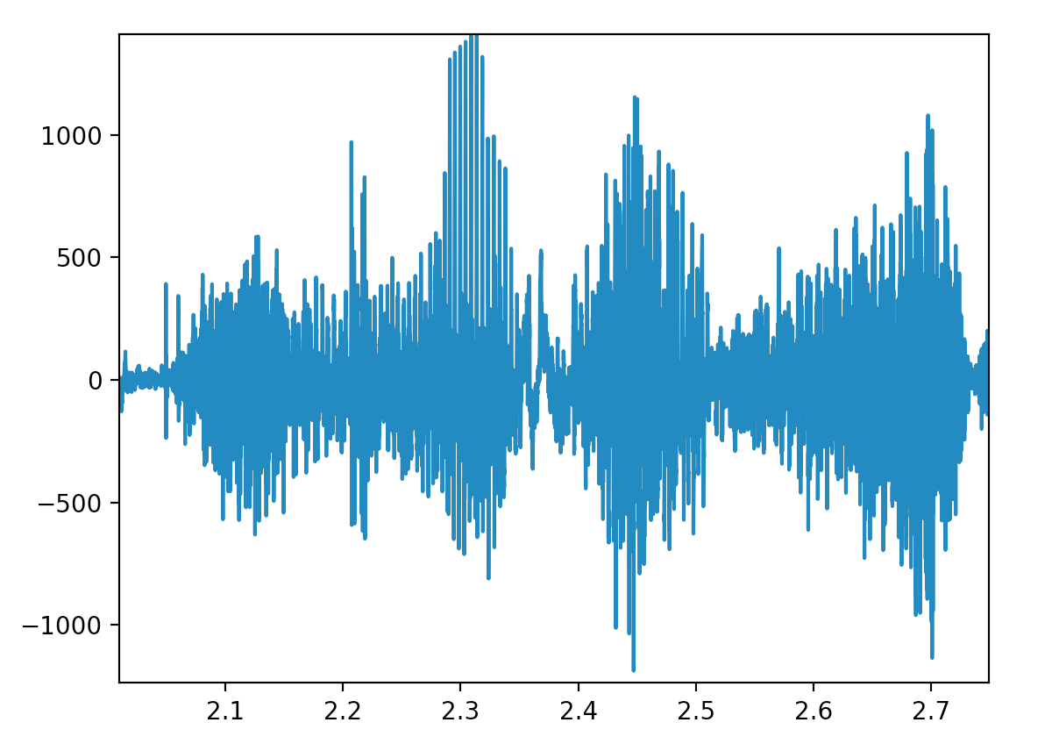
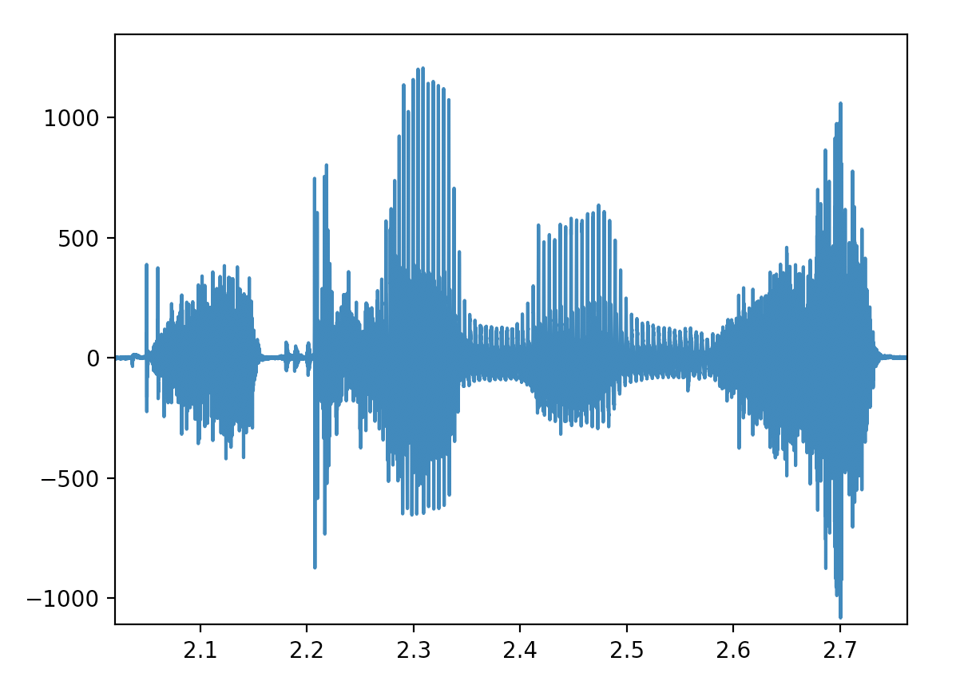
End-to-End Robust BPC-ASR (training loss)
Generate enhanced speech which can be classified into BPC labels more precisely.
Back-Propagation
Speech
Enhancement
End-to-End
Attention ASR
BPC
Labels
Noisy
Speech Signal
Enhanced
Speech Signal

Slide 17
Thanks!
Any questions?
You can find me at @vacuum42468 & neilyenjulu@gmail.com

